Slide 1

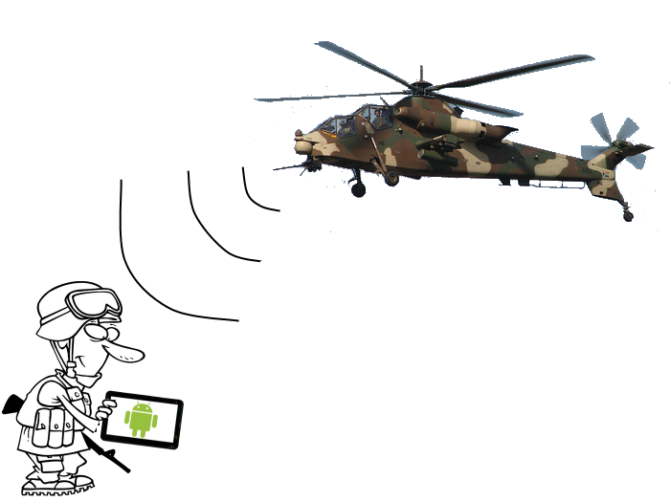
Raytheon Senior Design Project Android Based Situational Awareness: Moving Map
Gate 5: Kickoff
Date

Slide 2
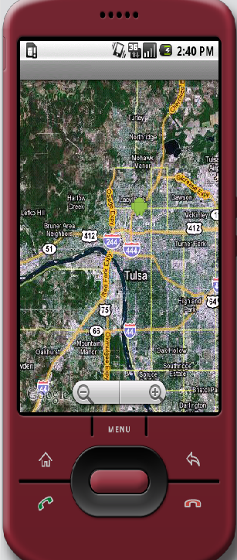
Project Overview
Background: There are no current Raytheon non-web based mapping applications on an Android device.
CONOPS: (Concept of Operations) The application is intended for soldiers, law enforcement officers, or other personnel without access to the Internet. The application will be compatible with Android devices.
Key Assumptions:
Raytheon will provide one 10” Samsung Galaxy Tablet
Critical Success Factors:
Selected a map engine by 9/26/2012
Screen shots of existing applications by 9/26/2012, and ask for screen shots of all required maps layers
Buyoff Criteria:
Final Release Demonstration for Raytheon Management
Successful completion of all university project requirements
Deliverables:
Program Documentation (Schedule, etc.)
Requirements/Architecture
System Design
Source Code/Executables
Demonstrations
Next Milestone:
System Reqs. Review (SRR) – 3 Oct 2012

Slide 3
Project Pictorial
Detailed Visual Project Overview
Block Diagram
Product Breakdown Structure
Graphics
Screen Shots
Logos
etc

Slide 4
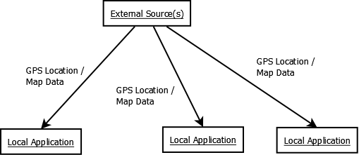
Project Decomposition

Slide 5
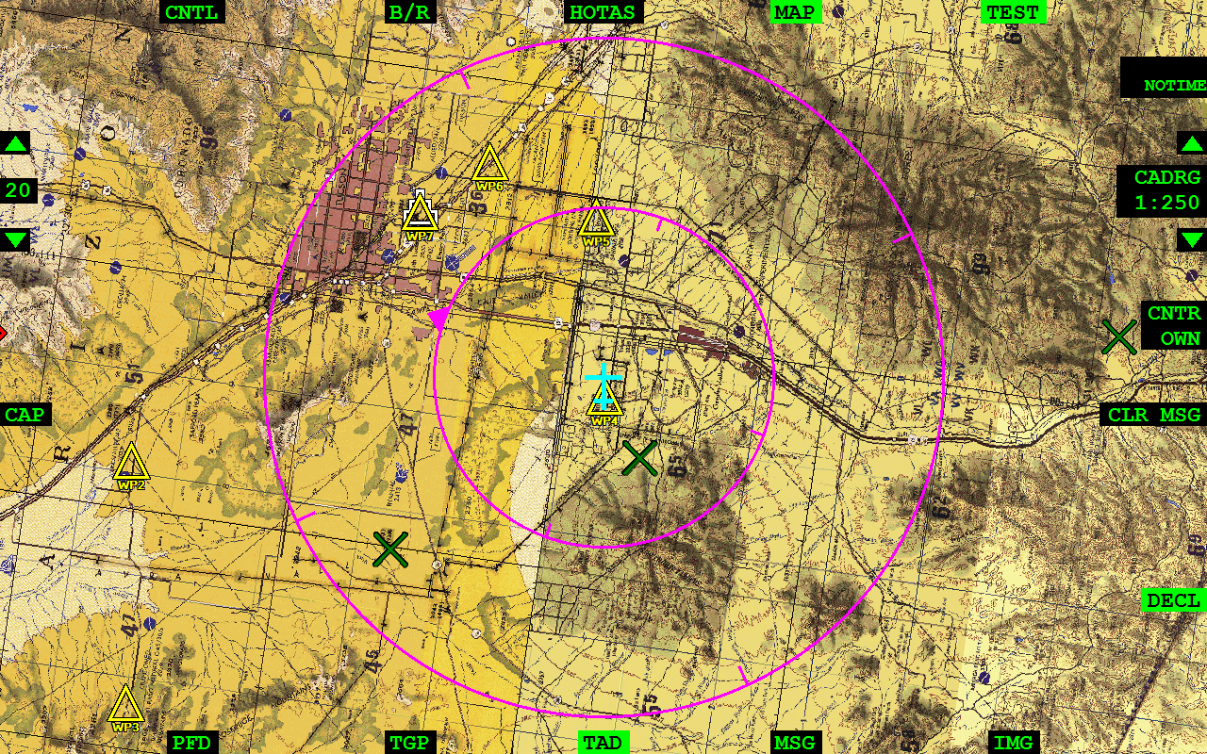
Existing Situational Awareness Software

Slide 6
Project Schedule & Milestones
Identify key program milestones with dates
Screen shot of schedule from Project

Slide 7
Project Team
Todd Lovell
Chief Engineer
TBD
Subject Matter Expert
J.D. Hill
Program Engineer
Michael Wollowski
Project Advisor
1st Quarter
Tom Atnip
Team Leader
Software Engineer
Susi Cisneros
Client Contact
Software Engineer
Sam Kim
Software Engineer
Seth Troisi
Software Engineer

Slide 8
Assumptions, Risks, & Opportunities
Find a mapping engine that supports the correct mapping format (Engine supports xyz format)
Libraries for pulling mapping information from local server (e.g. Wifi, USB)
Risks
dfghjk
Assumptions
Find a way to use already implemented mapping tools (e.g. panning, zooming)
Opportunities
fjkl

Slide 9
Backup Slides
Include extra slides if discussion goes ‘deeper’ and all slides from after meeting

Slide 10
Lessons Learned
Positive Items
Color code MS project Gannt to identify each resource
Etc.
Improvements or Changes
Example: Do not pull all nighter before meetings
Etc.

Slide 11
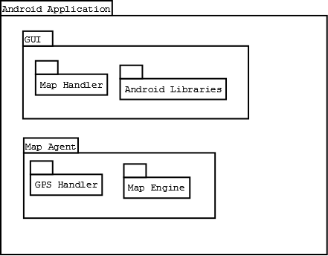
Project UML Diagram

